Slide 1
Stock Price Prediction using Different Machine Learning Models
And Compare the Performance of the Models

Slide 2
Group Members
Student ID | Student Name
IT18233704 | N.R. Yamasinghe
IT18156652 | M.D.D.M. Cooray
IT18213072 | Y.S. Ranasinghe
IT18209280 | D.M.Y.S. Dissanayake

Slide 3

Table of Contents
Introduction
Dataset
Selected Machine Learning Algorithms
Methodology
Implementation
Application
Results and Discussion

Slide 4
INTRODUCTION

Slide 5

INTRODUCTION
What is Stock Market?
Importance of Stock Market
Stock Price Prediction

Slide 6
DATASET

Slide 7

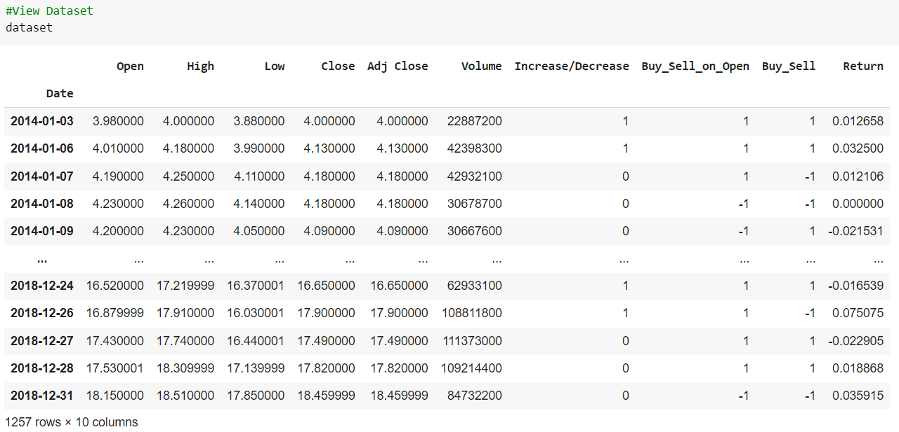
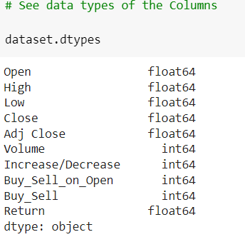
DATASET

Slide 8
MACHINE LEARNING ARCHITECTURES

Slide 9
MACHINE LEARNING ARCHITECTURES
Linear Regression
Logistic Regression
Bayesian Ridge Regression
Decision Tree Regression

Slide 10
METHODOLOGY

Slide 11
METHODOLOGY
Import Libraries
Load data into a Data Frame
Instantiate Model
Data Cleaning
Instantiate Loss
Training the Model
Data Preprocessing
Instantiate Optimizer
Prediction
Analyze the Data
Create Model
Prepare Dataset

Slide 12
IMPLEMENTATION

Slide 13
APPLICATION

Slide 14
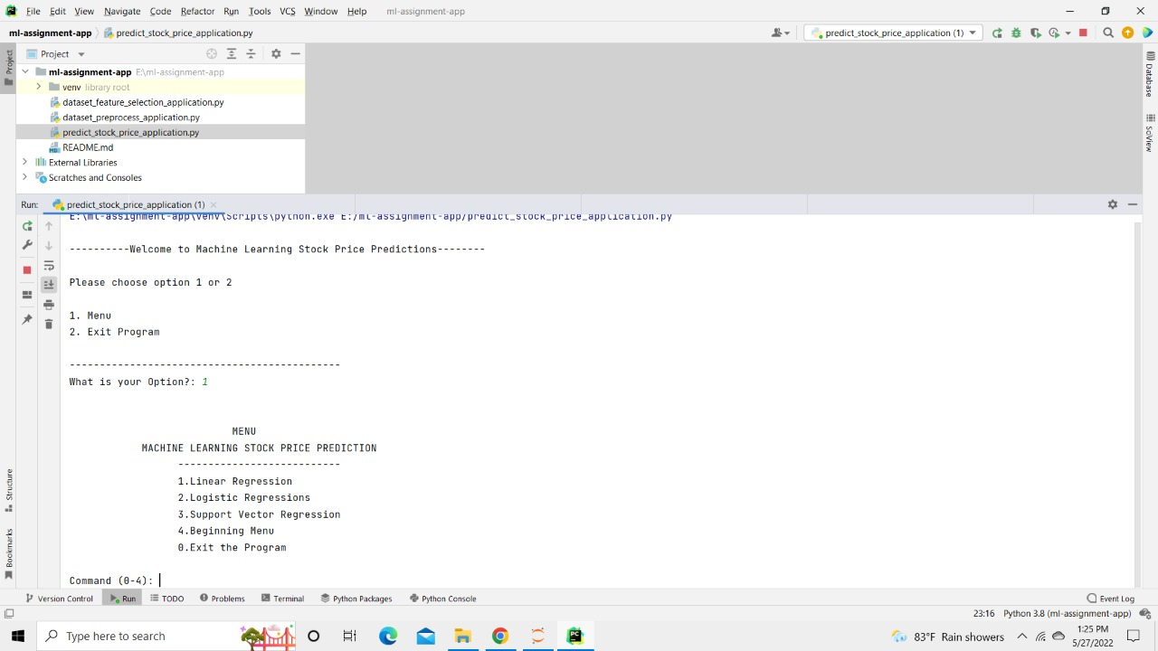
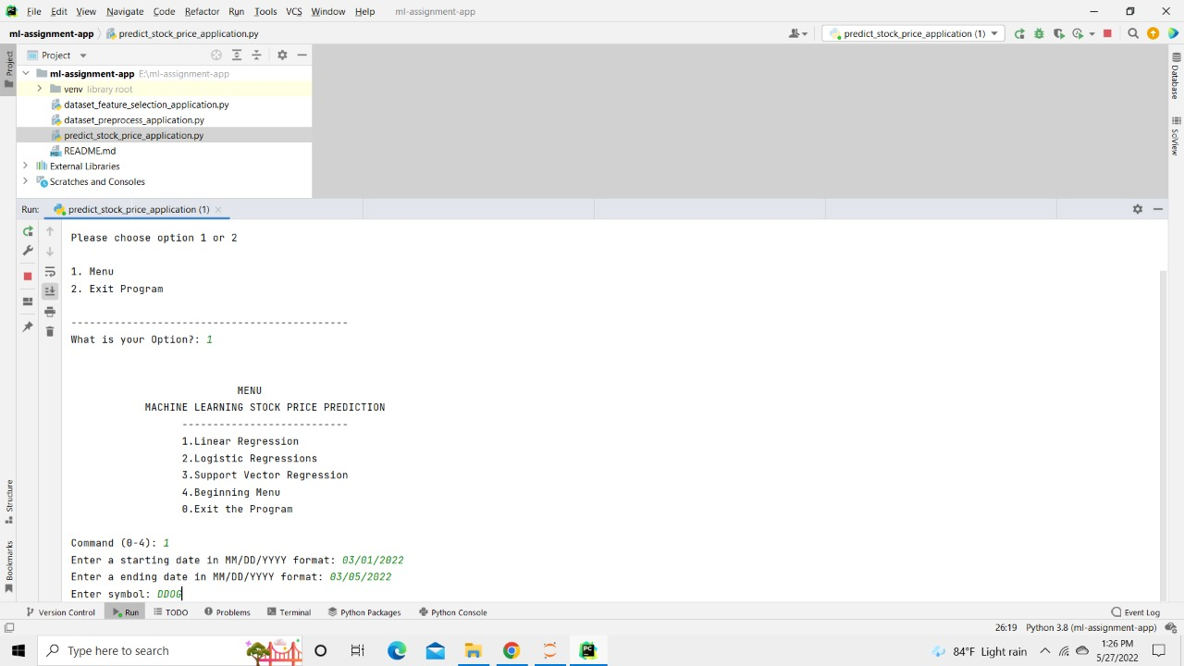
APPLICATION

Slide 15
RESULTS AND DISCUSSION

Slide 16
RESULTS AND DISCUSSION
Model | MAE | MSE | RMSE | Log Loss | Accuracy
Linear Regression | 0.061703 | 0.010497 | 0.102454 | - | 0.999571
Logistic Regression | - | - | - | 0.70 | 0.542662
Decision Tree Regression | 0.103461 | 0.034138 | 0.184767 | - | 0.998595
Bayesian Ridge Regression | 0.146670 | 0.051846 | 0.227698 | - | 0.997867

Slide 17
THANK YOU!

